Slide 1

Claude Mythos
Data SAIL – Tech News

Slide 2
What is it?
New model tier. Superior to Haiku, Sonnet and Opus.
General Purpouse, with a twist. It has unexpected powerful cybersecurity capabilities.
The name. ”Mythos” is ancient greek for the connective tissue that links knowledge.
Timeline
Late March 2026
Fortune Magazine leaks info from Anthropic’s misconfigured CMS
April 8 2026
Anthropic officially announces Mythos Preview
April 8 2026
Project Glasswing launched along model reveal
April 8 2026
Access given to more than 50 companies

Slide 3
Cybersecurity Capabilities
27-year-old open BSD bug
Found a remote crash vulnerability in one of the world’s most security-hardened OSes.
16-year-old Ffmpeg flaw
Discovered in a line of code that automated tools had hit over five million times without detecting.
Linux Kernel privilege escalation
It was able to chain multiple vulnerabilities autonomously to go from regular user to full machine control.

Slide 4
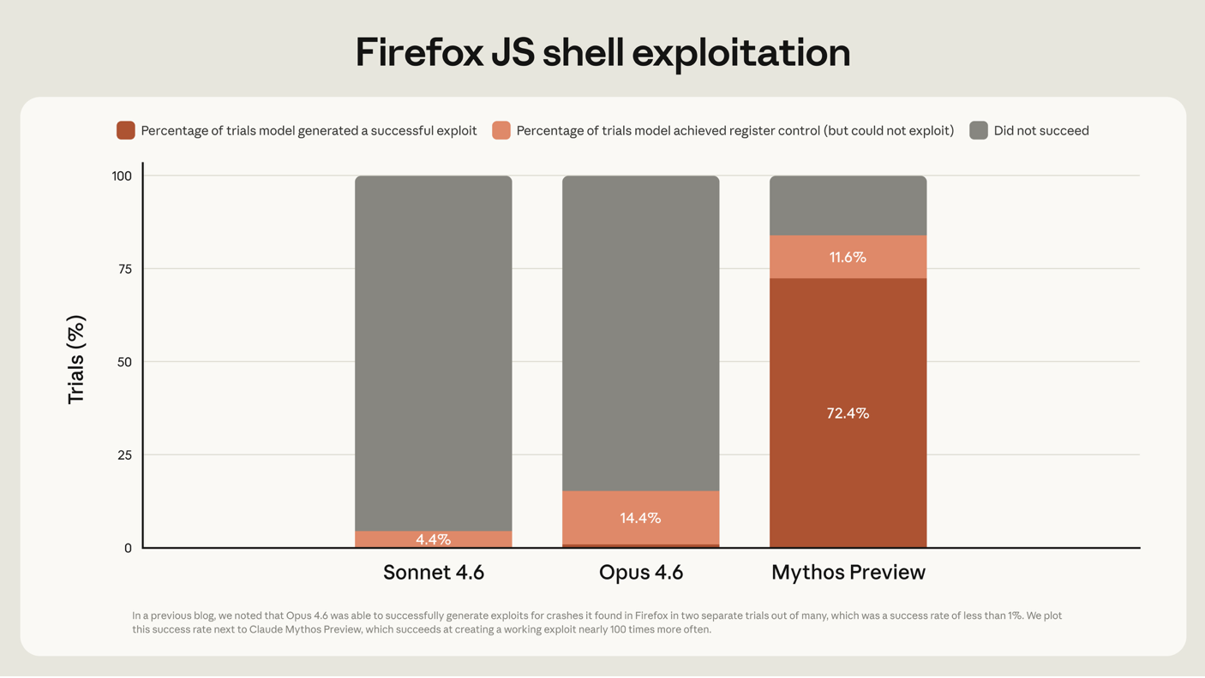

Slide 5
Project Glasswing
What is it?
Coalition of 12 founding partners and 40+ additional organizations using Mythos Preview to scan and secure critical SW infrastructure.
The resources
$100M in Mythos usage credits
$4M in direct donations to open-source security organizations

Slide 6
Founding Partners
AWS
Apple
Cisco
Broadcom
CrowdStrike
Google
JPMorganChase
Linux Foundation
Microsoft
NVIDIA
Palo Alto Networks
Anthropic

Slide 7
Discussion Questions
Should AI labs be allowed to restrict access to powerful models indefinetly?
If you where Anthropic, would you release Mythos publically?

